Slide 1




CONNECTICUT REAL ESTATE
ANALYSIS
BY GROUP 3

Slide 2
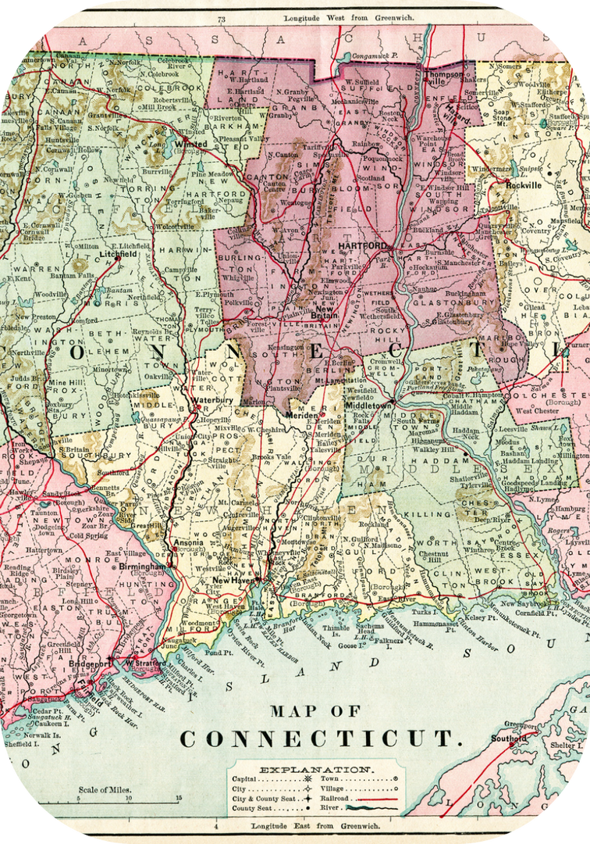
Introduction:
We are Group 3 Investment, a distinguished investment firm specializing in the analysis of the Connecticut real estate market.
Our esteemed clientele comprises high-net-worth investors keen on exploring lucrative opportunities within the Connecticut real estate sector.
Connecticut boasts the 7th highest income per capita in the United States, offering a promising landscape for discerning investors seeking strategic investment ventures.

Slide 3

Our Objective
OUR VISION
To revolutionize community living in Connecticut by developing innovative and sustainable living spaces that not only elevate lifestyles but also foster community well-being and environmental stewardship.
OUR MISSION
Our mission is to create unparalleled value for our stakeholders by leveraging data-driven insights and cutting-edge technologies in real estate investment. We are committed to ethical decision-making that prioritizes long-term wealth generation, community enhancement, and environmental sustainability.

Slide 4


Our Values
At Group 3 Investment, we are deeply committed to enriching communities by delivering exceptional living spaces through strategic and mindful investment.
Our approach is rooted in a profound respect for quality, innovation, and sustainability.
By emphasizing ethical practices, engaging with our communities, and prioritizing environmental stewardship, we aim to redefine the standards of real estate investment.

Slide 5

Problem Statement
Group 3 Investment faces several challenges hindering the achievement of its strategic objectives and overarching goals:
Limited Portfolio Expansion:
Struggle to expand portfolio by 20% in the next five years due to difficulty in identifying suitable acquisition targets aligned with community enhancement and environmental stewardship mission.
Inefficient Operations:
Challenges in effectively implementing AI and big data analytics to streamline property management processes and improve customer satisfaction, hindering the target of 30% operational efficiency boost by 2026.

Slide 6



COMPETITOR ANALYSIS
S
STRENGTHS
W
WEAKNESSES
Brand recognition
Extensive Data and Listings
Accuracy of Zestimates
Competition from Traditional Real Estate Agents
O
OPPORTUNITIES
T
THREATS
International Expansion
Diversification into Additional Services
Competitive Landscape
Economic Factor

Slide 7
COMPETITOR ANALYSIS
GROUP 3 INVESTMENT
S
STRENGTHS
W
WEAKNESSES
Regional Expertise
Well-structured Analysis
Technology integration
Small Group
Less option
O
OPPORTUNITIES
T
THREATS
High Income Area
Numbers talk
Online platform
Preference of consumer

Slide 8

WHY ARE WE DIFFERENT?
At Group 3 Investments, we differentiate ourselves through our localized focus, community-centric approach, regional expertise, and commitment to sustainable and innovative practices.
With a deep-seated belief in the power of community engagement, we prioritize building robust relationships within local communities across Connecticut.
Our regional expertise ensures that we understand the unique dynamics of each neighborhood, allowing us to tailor our services to meet the specific needs and aspirations of residents.
Moreover, our dedication to sustainable and innovative practices drives us to continually explore new ways to enhance environmental stewardship and elevate living standards, setting us apart as leaders in the industry.

Slide 9
DATASET DESCRIPTION
Our data is from State of Connecticut on data.gov
Our data is include 2001-2020 sales data from Connecticut
The raw dataset have 997213 rows and 14 columns
After cleaning data, we add some meaningful column base on the raw data and our new dataset has 60967 rows and 18 columns.
Serial.Number | Residential.Type | Sales.Ratio | Sale_Category
List.Year | SaleYear | Address | AvgLendingRate
Date.Recorded | SaleMonth | Downturn | Sale.Amount
Town | Pandemic | Assessed.Value | County
Property.Type | Residential_Category

Slide 10
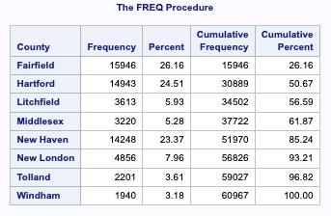
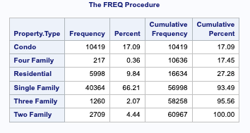
DATASET DESCRIPTION
Maximum No of Units are concentrated in Three Counties: Fairfield, Hartford and New Haven
Major Types of Unit are Single Family and Condo

Slide 11
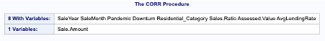
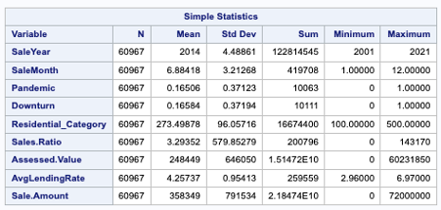
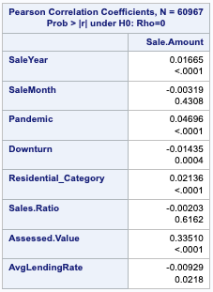
DATASET: CORRELATION
Correlation Analysis indicates that only Assessed Value and Avg Lending Rate are Significant Variables

Slide 12
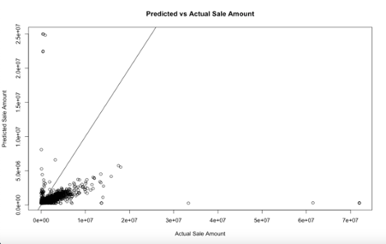
DATASET: REGRESSION
Independent Variables: Assessed Value, Average Lending Rate
Dependent Variable: Sale Amount
Intercept: 275,500
Coeff. 1 (Assessed Value): 0.41
Coeff.2 (AvgLendingRate): 4,491
R-Squared (Adj.): 11.23%
Sale.Amount=275,500+(0.41×Assessed.Value)−(4,491×AvgLendingRate)

Slide 13
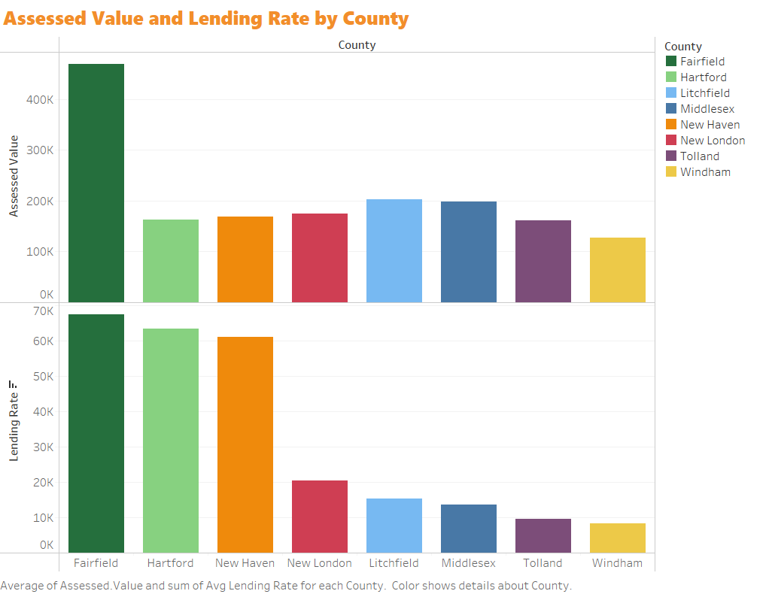
ASSESSED VALUE AND LENDING RATES

Slide 14
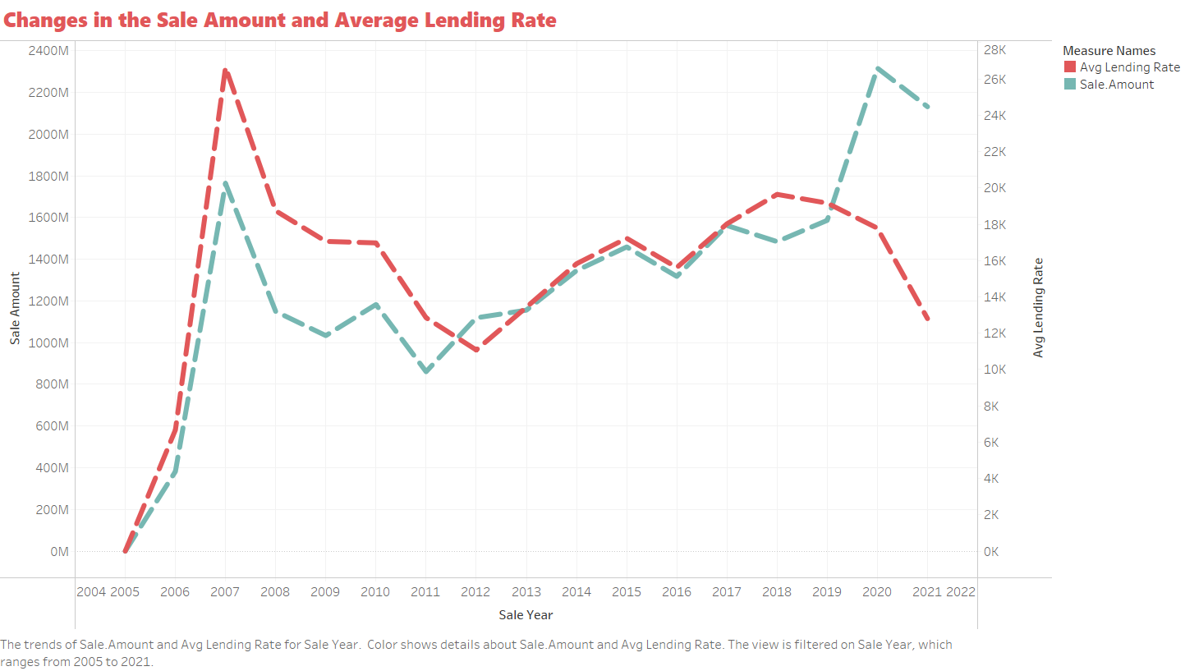

Slide 15
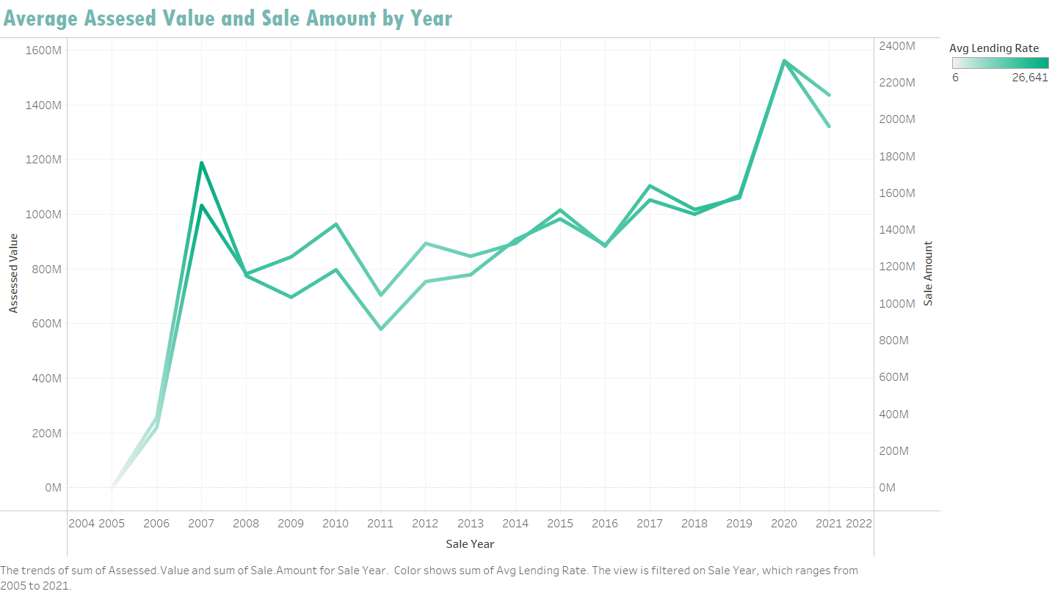

Slide 16
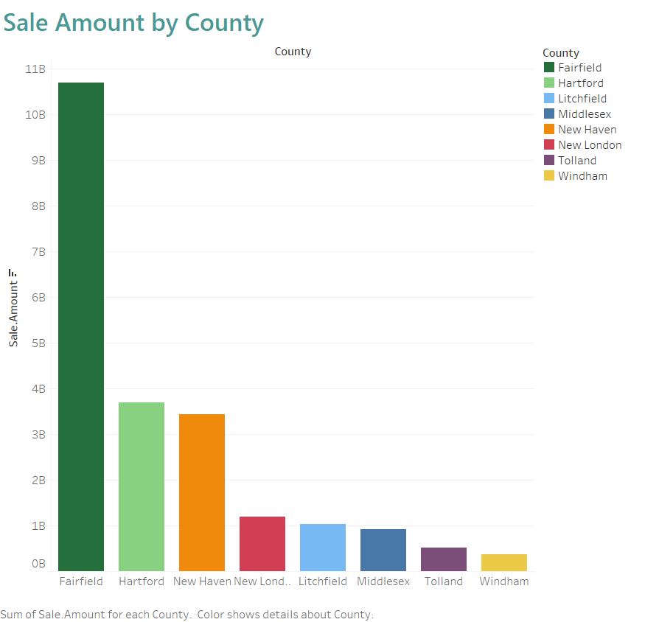
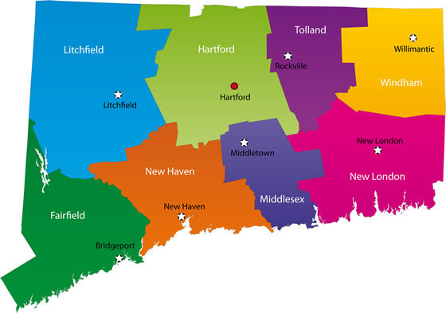

Slide 17
Summary of the Analysis
Implications for Stakeholders
Limitations and Considerations
Areas of further research
Recommendations

Slide 18
THANK YOU!

